Slide 1

MATH30
Probability and Statistics

Slide 2
Correlation
The correlation between two random variables X and Y is a measure of the degree of linear association between the two variables.
Two variables are highly correlated if they move well together. Correlation is indicated by the correlation coefficient.
The population correlation coefficient is denoted by ρ. The coefficient ρ can take on any value from −1, through 0, to 1.

Slide 3
Possible Interpretations of ρ and interpretations
When ρ is equal to zero, there is no correlation. That is, there is no linear relationship between the two random variables.
When ρ=1, there is a perfect, positive, linear relationship between the two variables. That is, whenever one of the variables, X or Y, increases, the other variable also increases; and whenever one of the variables decreases, the other one must also decrease.
When ρ=−1, there is a perfect negative linear relationship between X and Y. When X or Y increases, the other variable decreases; and when one decreases, the other one must increase.
When the value of ρ is between 0 and 1 in absolute value, it reflects the relative strength of the linear relationship between the two variables. For example, a correlation of 0.90 implies a relatively strong positive, relationship between the two variables. A correlation of −0.70 implies a weaker, negative (as indicated by the minus sign), linear relationship. A correlation ρ=0.30 implies a relatively weak (positive) linear relationship between X and Y.

Slide 4
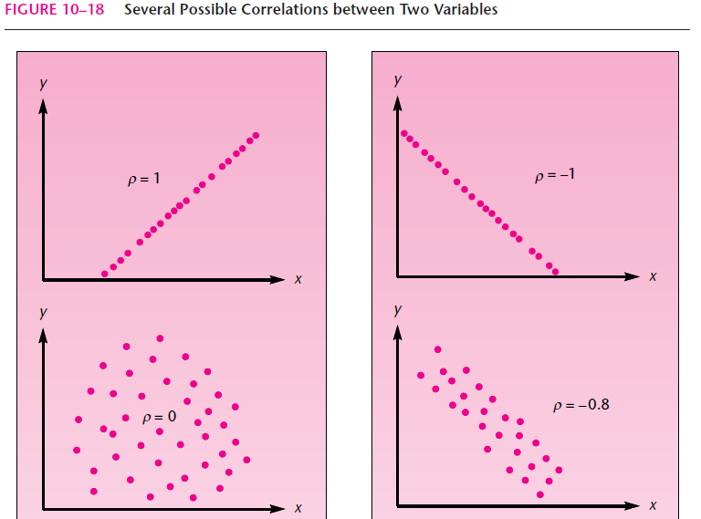
Correlation

Slide 5
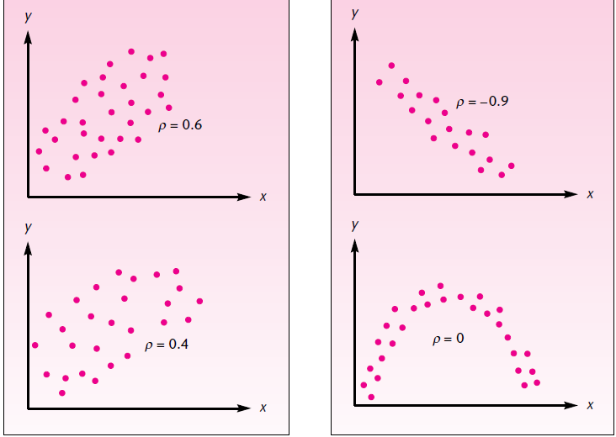
Correlation

Slide 6
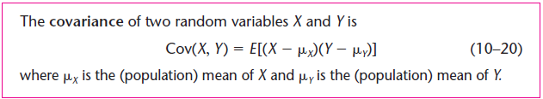

Correlation
How do we arrive at the concept of correlation? Consider the pair of random variables X and Y. In correlation analysis, we will assume that both X and Y are normally distributed variables with means μ_{X} and μ_{Y} and standard deviations σ_{X} and σ_{Y}, respectively. We define the covariance of X and Y as follows:
$$Cov\left(x,y\right)=\frac{\sum{\left(X−μ_{X}\right)\left(Y−μ_{Y}\right)}}{N}$$

Slide 7
Correlation
The covariance of X and Y is thus the expected value of the product of deviation of X from its mean and the deviation of Y from its mean. The covariance is positive when the two random variables move together in the same direction, it is negative when the two random variables move in opposite directions, and it is zero when the two variables are not linearly related. Other than this, the covariance does not convey much. Its magnitude cannot be interpreted as an indication of the degree of linear association between the two variables, because the covariance’s magnitude depends on the magnitude of the standard deviations of X and Y. But if we divide the covariance by these standard deviations, we get a measure that is constrained to the range of values −1 to 1 and conveys information about the relative strength of the linear relationship between the two variables. This measure is the population correlation coefficient ρ.

Slide 8
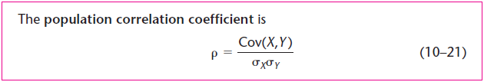
Correlation

Slide 9
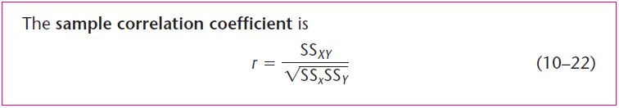
Sample Correlation Coefficient
This is the estimate of ρ, also referred to as the Pearson product-moment correlation coefficient.

Slide 10
Coefficient of Determination
The coefficient of determination r² is a descriptive measure of the strength of the regression relationship, a measure of how well the regression line fits the data.
The coefficient of determination r² is an estimator of the corresponding population parameter ρ², which is square of the population coefficient of correlation between two variables X and Y. Usually, however, we use r² as a descriptive statistic−a relative measure of how well the regression line fits the data. Ordinarily, we do not use r² for inference about ρ².

